Slide 1
Title: Customer Service Analysis Report – Flipkart
Subtitle: Analyzing Data to Improve Customer Retention.
Prepared by: Pratik Garud.
Date: 5/9/2025

Slide 2
Problem Summary-
The primary objective of this project is to analyze customer call data and assess various aspects of customer service performance to determine if and how it impacts customer retention. The goal is to identify specific issues within customer service operations that may be affecting customer satisfaction and retention rates.
Goal-
The main goal of this project is to uncover insights into Flipkart’s customer service operations to improve customer retention. You will analyze the provided dataset to understand how customer service factors impact customer retention and identify specific areas where improvements are needed.

Slide 3
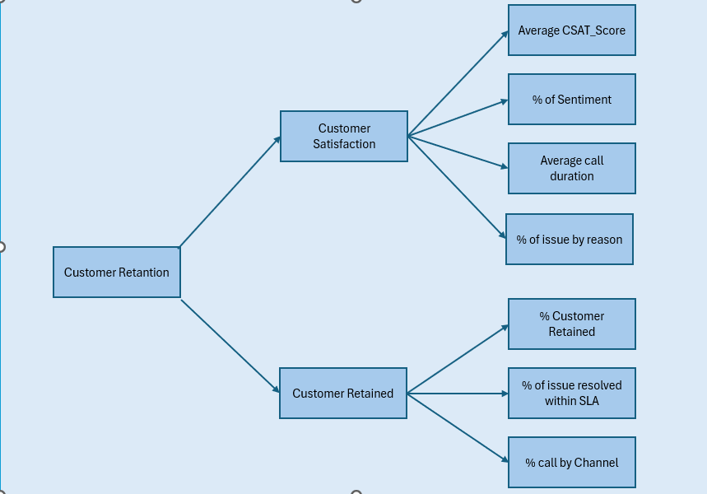
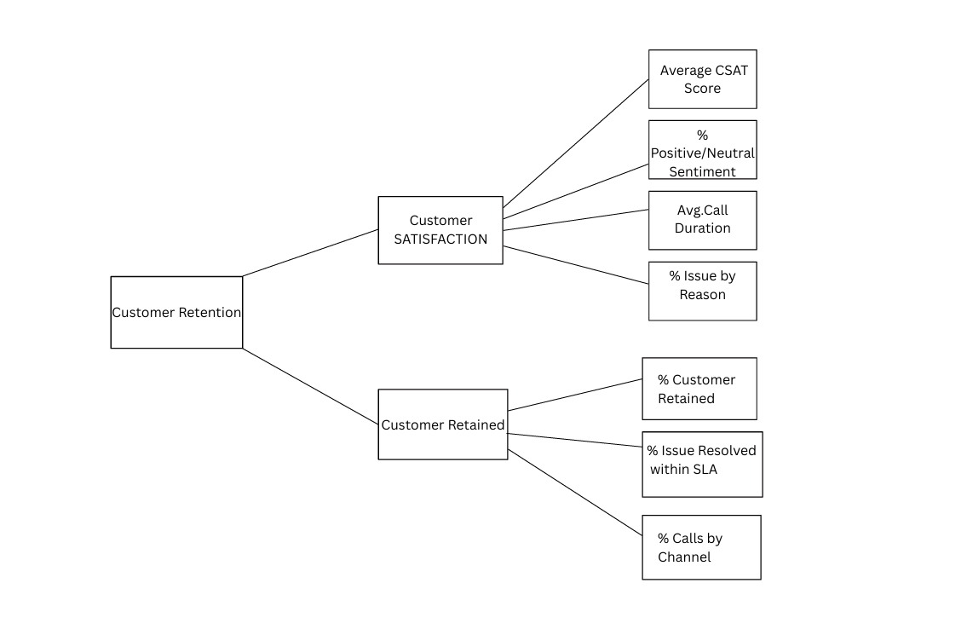
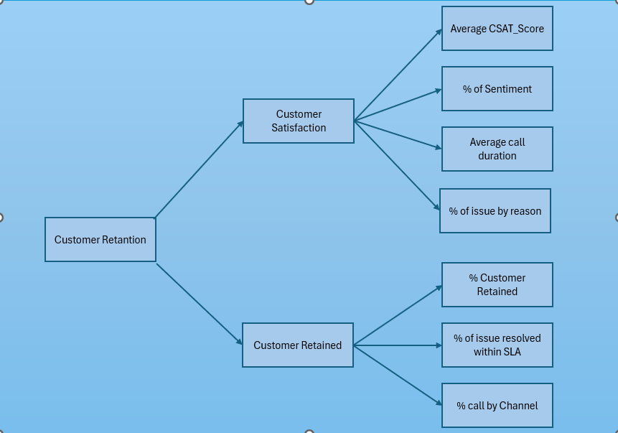
Metric Tree-

Slide 4
1. % Issue by Reason:Percentage of calls for each issue type (e.g., delivery, refund, payment).
= (COUNTIF(Issue_Column,"Refund") / COUNTA(Issue_Column)) * 100
2. % Customer Retained:Percentage of customers retained after service interaction.
3. % Issue Resolved within SLA :Percentage of customer issues resolved within agreed response time.
= (COUNTIF(Resolution_Time_Column,"<=SLA_Limit") / COUNTA(Resolution_Time_Column)) * 100
4. % Calls by Channel:Distribution of calls by communication channel (Phone, Chat, Email, App).
= (COUNTIF(Channel,"Phone") / COUNTA(Channel)) * 100

Slide 5
5. Customer Retention:Percentage of customers who continue shopping with Flipkart after interacting with customer service.
= (Retained Customers / Total Customers) * 100
6. Customer Satisfaction (CSAT Score):Average satisfaction rating given by customers after service interaction.
= AVERAGE(CSAT Score)
7. % Positive/Neutral Sentiment:
= ((COUNTIF(Sentiment,"Positive") + COUNTIF(Sentiment,"Neutral")) / COUNTA(Sentiment)) * 100
8. Average Call Duration:Average length of customer service calls.
= AVERAGE(Call_Duration)

Slide 6
Hypotheses-
H1: Better sentiment (positive tone) → higher CSAT → higher retention.
Hypothesis 1: Positive customer sentiment leads to higher CSAT and better retention.

Slide 7
Hypotheses-
H2: Shorter call duration with issue resolution improves satisfaction.
Hypothesis: Shorter call duration with issue resolution boosts customer satisfaction.

Slide 8
Hypotheses-
H3: Some support channels are more effective at resolving issues, leading to higher CSAT Scores.
Hypothesis 3: The call center and web, had higher CSAT scores compared to others.

Slide 9
Hypotheses-
H4: Reduce response time to minimize Above SLA cases can help in customer retention

Slide 10
Hypotheses-
H5: Facilitating more training sessions for Delhi and Mumbai call centers, as they get the highest volume of calls, can help in customer retention.

Slide 11
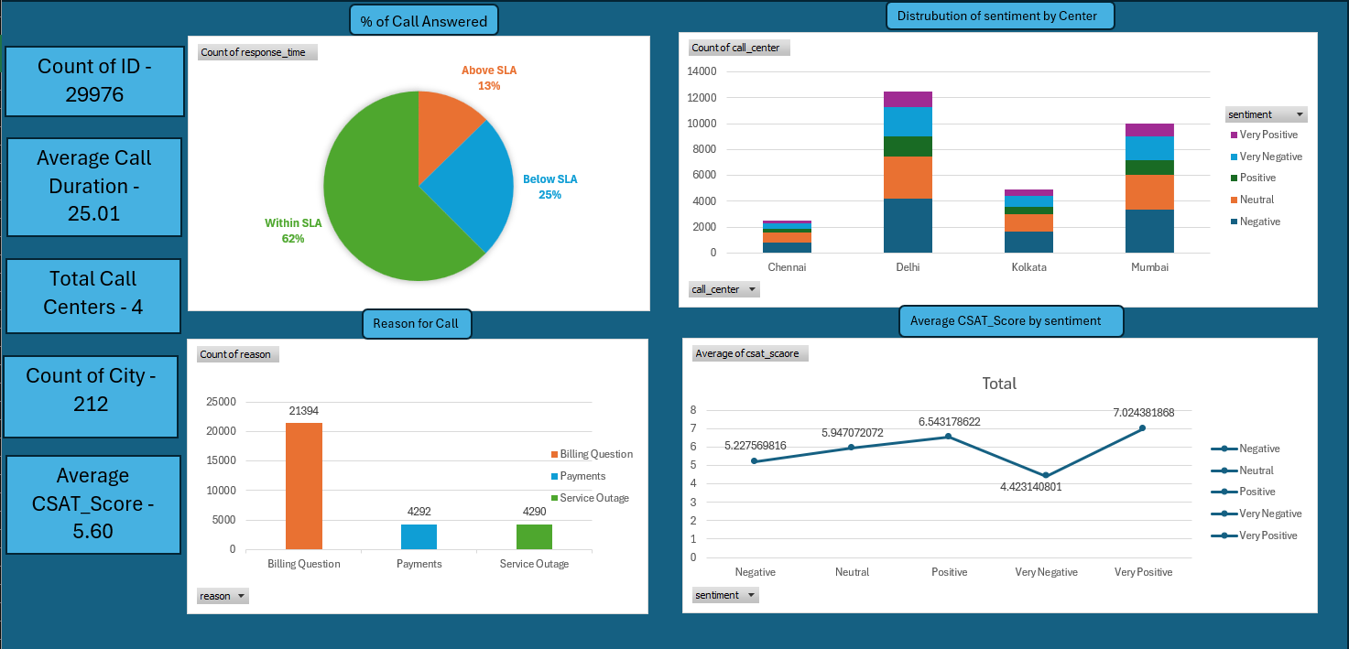
Dashboard -

Slide 12
Key Insights-
Overall Customer Satisfaction (CSAT):Average CSAT Score = 5.62 (out of 10), indicating moderate satisfaction with significant room for improvement.
Sentiment vs CSAT:Around 33% of interactions are negative, which is a concern.
Channel Performance:Call Center has slightly better CSAT (5.64) compared to Chatbot, Email, and Web (~5.59).
Reason for Calls:Billing Questions dominate (≈70% of calls), far more than Payments or Service Outages.
Indicates customers struggle the most with billing-related clarity or errors.

Slide 13
Recommendations-
Improve Billing Support Processes:Train agents specifically on billing queries since they represent the majority of issues.
Channel Optimization:Call Center is slightly ahead, but reliance on it creates workload imbalance.
Redistribute Call Center Load:Delhi is overloaded compared to Chennai/Kolkata.
Sentiment-Driven Interventions:For customers flagged as “Negative/Very Negative,” implement follow-up recovery calls or discounts to rebuild trust.

Slide 14
Conclusion-
To enhance customer experience, Flipkart should prioritize billing process improvements, focus on service quality over speed, strengthen digital channels, and rebalance call center operations. By addressing these areas, the company can reduce negative sentiment, improve CSAT, and boost overall customer retention.

